Slide 1


Yahoo's Acquisition of Tumblr Data Science for Business AA Joana Ribeiro | Miroslav Sala | Ricardo Ferreira | Sara Ricardo | Slava Kholodov

Slide 2

Main questions to address
Valuation through historical data
Forecast through time series
Valuation through time series

Slide 3
Tumblr’s valuation is extremely sensitive to the growth assumption of its future audience (USD 0.9-63.7 billion)
1
Monthly growth rate CAGR. Percentage
Tumblr’s users in 2022² Billion. Estimated
Model used by Yahoo!
Tumblr’s valuation³ USD Billion. Estimated
Worldwide
USA
Worldwide
USA
Average monthly rate since inception (last 37 months)
Approach #1: straightline decline in US audience
N.a.¹
8.5
63.7
5.47%
47.3
Approach #2: US growth rate in line with historical rate
4.56%
6.0
56.3
Average monthly rate of the last 12 months
Approach #1: straightline decline in US audience
N.a.¹
0.1
1.2
1.52%
0.7
Approach #2: US growth rate in line with historical rate
-0.02%
<0.1
0.9
1 Not applicable, as growth rate depends on the evolution of the worldwide population and the straightline decline until Facebook’s 18% is reached in 2022 (from 33% in 2013)
2 Monthly average
3 Taking into account the same assumptions for people-to-user equivalency, revenue per user and cash margin

Slide 4
Main questions to address
Valuation through historical data
Forecast through time series
Valuation through time series

Slide 5
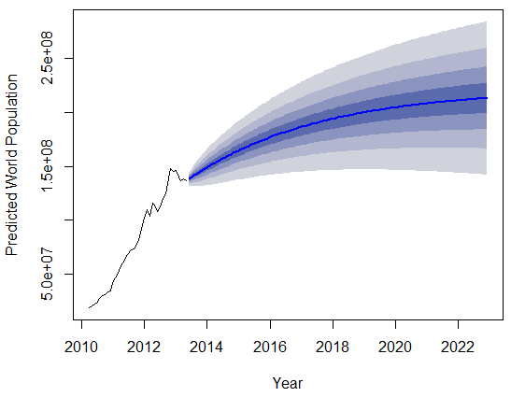
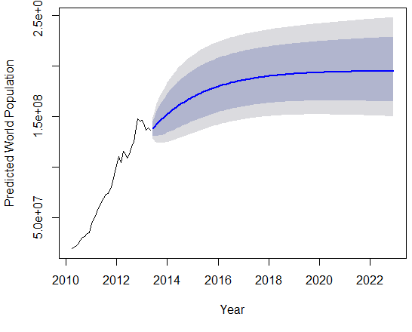
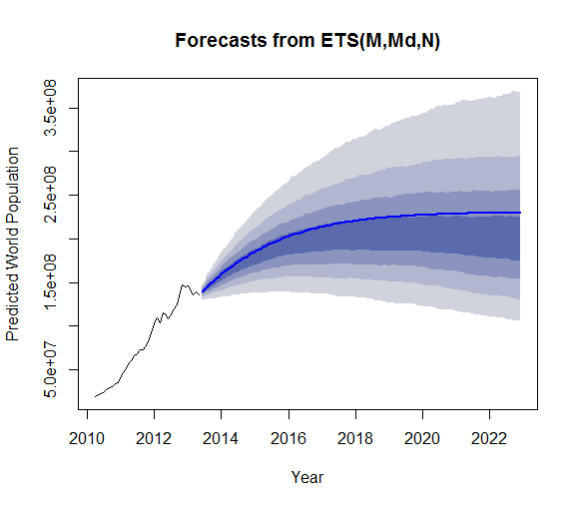
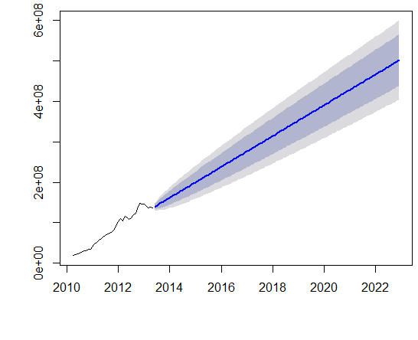
When building the model to forecast Tumblr’s future users, we took into account the most realistic trend (1/2)
2
Forecast models of Tumblr’s users. Worldwide
Approach
Define different time series for worldwide and USA based on Tumblr’s historical monthly users
Create forecast models, namely:
Exponential smoothing models (e.g., AAN, MMN, AAZ, MMZ)
TBATS model
ARIMA model
Assess quality of the forecasts based on “damped” vs. “straightline” trend and AIC. Argument for damped forecast – market saturation.
Exponential smoothing model
Other models
Additive – ETS(A,Ad,N)
TBATS model
Multiplicative – ETS(M,Md,N)
ARIMA model (with drift)

Slide 6
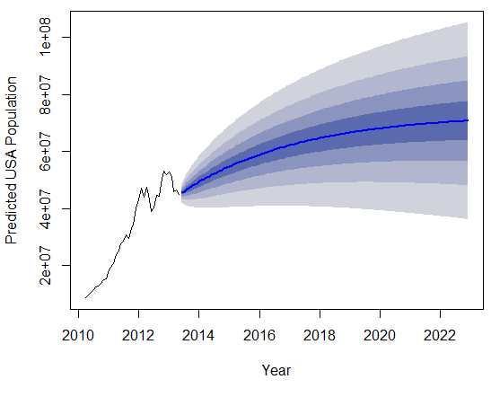
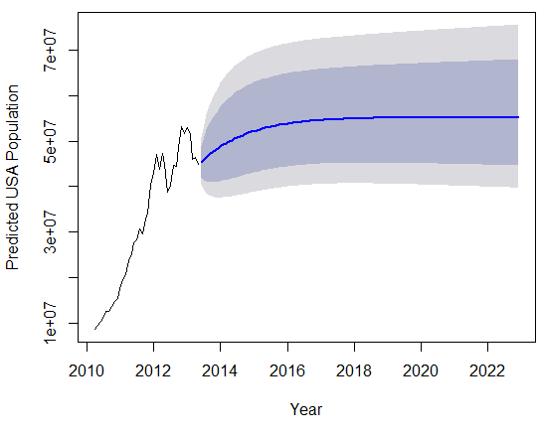
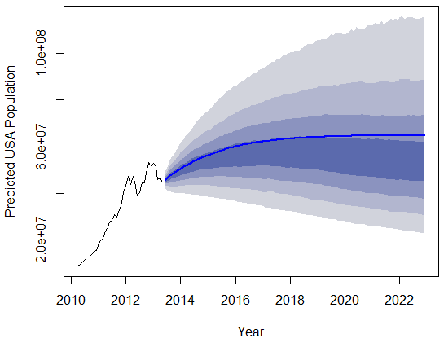
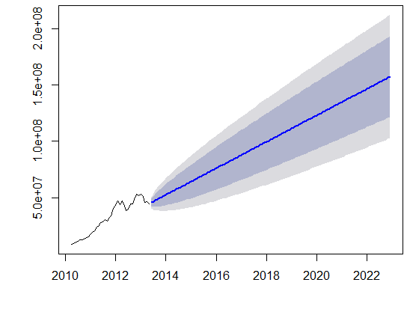
When building the model to forecast Tumblr’s future users, we took into account the most realistic trend (2/2)
2
Forecast models of Tumblr’s users. USA
Approach
Define different time series for worldwide and USA based on Tumblr’s historical monthly users
Create forecast models, namely:
Exponential smoothing models (e.g., AAN, MMN, AAZ, MMZ)
TBATS model
ARIMA model
Assess quality of the forecasts based on “damped” vs. “straightline” trend and AIC. Argument for damped forecast – market saturation.
Exponential smoothing model
Other models
Additive – ETS(A,Ad,N)
TBATS model
Multiplicative – ETS(M,Md,N)
ARIMA model (with drift)

Slide 7
The forecasted figures for both US and RoW show a significant gap vs. the model used by Yahoo!
2
Gap between new forecast models vs. model used by Yahoo!
Population¹. Million
AAZ
TBATS
MMZ
ARIMA
Worldwide
100
0
-100
-200
-300
-400
-500
-600
USA
40
20
0
-20
-40
-60
-80
1 Annual average

Slide 8
Main questions to address
Valuation through historical data
Forecast through time series
Valuation through time series

Slide 9
Based on the new forecast models, we estimate Tumblr’s valuation to be around USD 450 to 600 million
3
Tumblr’s valuation based on the different forecast model
USD Million. Estimated
Considering straightline decline in US audience vs. worldwide¹
Considering independent forecast for US audience
Methodology
Valuation model does not take into account results from ARIMA model, as it shows a straightline trend, thus not taking into account potential effects from market saturation
Key financial metrics (i.e., revenues and cash margin, discount rate) and user comparison metrics (e.g., people-to-user equivalency, engagement multiplier) aligned with the initial valuation model proposed by Yahoo!
Potential synergies between Yahoo! and Tumblr are not considered in evaluation
593.9
604.0
522.0
526.3
Average 530
478.6
454.2
TBATS
A,Ad,Z
TBATS
M,Md,N
A,Ad,N
M,Md,N
1 In line with the assumption used in Yahoo!’s initial valuation model (decline from 33% to 18% of total population)

